Slide 1
EDW Star Schema PK Violation Troubleshooting Made Easy
Bryan L. Mack BI Developer/Team Lead Colorado Community College System

Slide 2
What’s the problem?
In Ellucian’s EDW – error records are written off to a WKE_* table when they can’t be inserted to the WTT_*_WKEYS table due to a primary key error.
How do we find these troublesome records’ ODS data that is causing the PK violation?

Slide 3
The error you’ll see

Slide 4
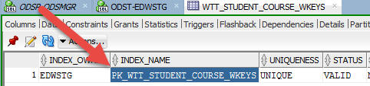
The Hard Way
1) Find the constraint in the WKEYS table

Slide 5
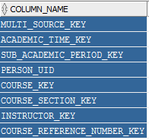
The Hard Way
2) Find the fields in the PK

Slide 6
The Hard Way
3) Find the dimension tables associated with each PK element. Use common sense to do this, if you have none of that, use deductive reasoning.
MULTI_SOURCE_KEY = WDT_MULTI_SOURCE PERSON_UID = WDT_PERSON ACADEMIC_TIME_KEY = WDT_ACADEMIC_TIME

Slide 7
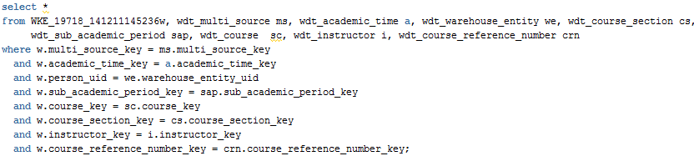
The Hard Way
4) Build a SQL query using joins on the keys from the WKE table & each of your dimensions

Slide 8
The Hard Way
5) Use logic to replace (*) in your query from step 4 with the fields you want to see.
WDT_MULTI_SOURCE = multi_source WDT_ACADEMIC_TIME = academic_period WDT_INSTRUCTOR = instructor_name
Etc.

Slide 9
Developing The Easy Way
That was way too much work.
We all love reusable code, right?
Good – let’s write some

Slide 10
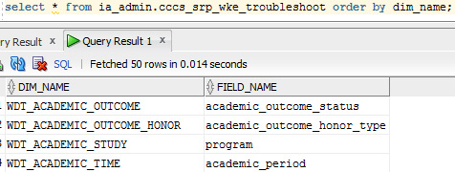
Developing the Easy Way
1) Create table with the relevant fields you want to see from each dimension should a PK error occur. Sure, this will take you an hour or so and is tedious; View it as an investment.

Slide 11

Developing the Easy Way
2) Write a function to do everything else for you.

Slide 12
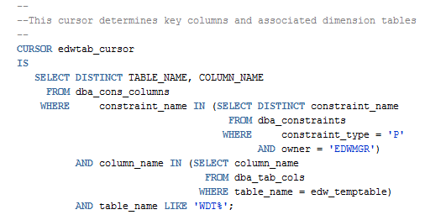
Developing the Easy Way
Find the key columns & proper dimensions

Slide 13
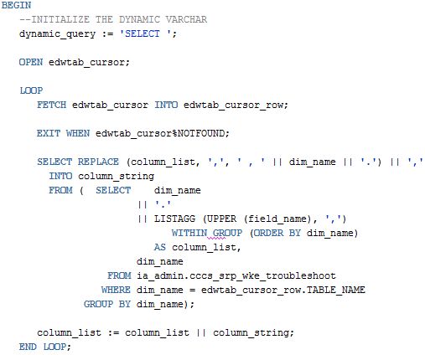
Developing the Easy Way Build your custom SQL block
Create your custom SELECT SQL statement

Slide 14
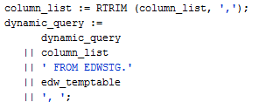
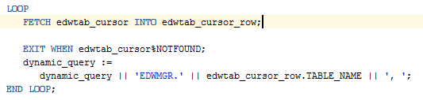
Developing the Easy Way Build your custom SQL block

Slide 15

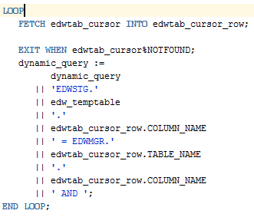
Developing the Easy Way Building your custom SQL block

Slide 16
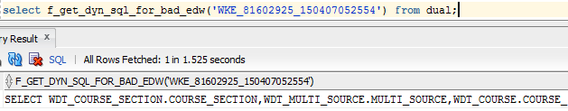
Using the Easy Way
1) Call your function with your WKE_* table name as the sole input:

Slide 17
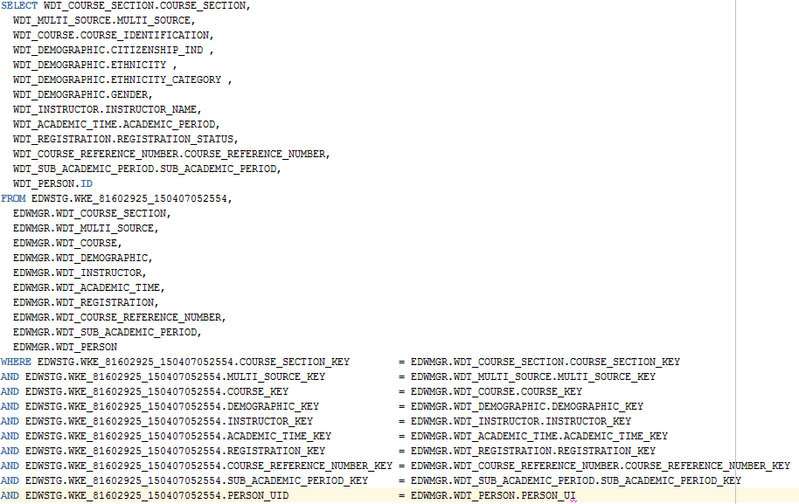
Using the Easy Way
The function creates your SQL for you

Slide 18
Using the Easy Way
2) Run that SQL

Slide 19
Questions?
Bryan L. Mack
bryan.mack@cccs.edu

